Slide 1
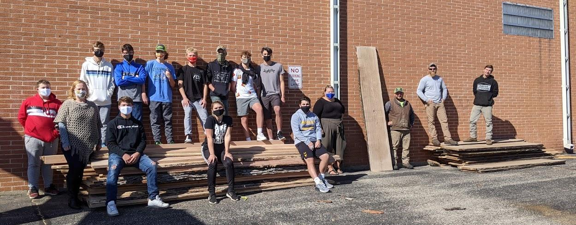
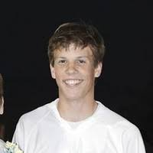
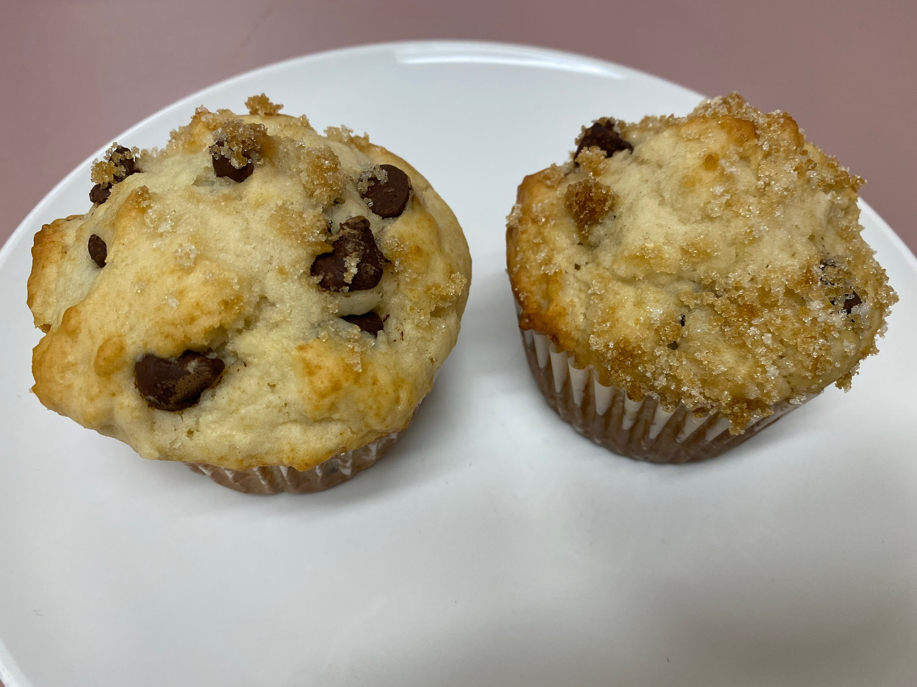
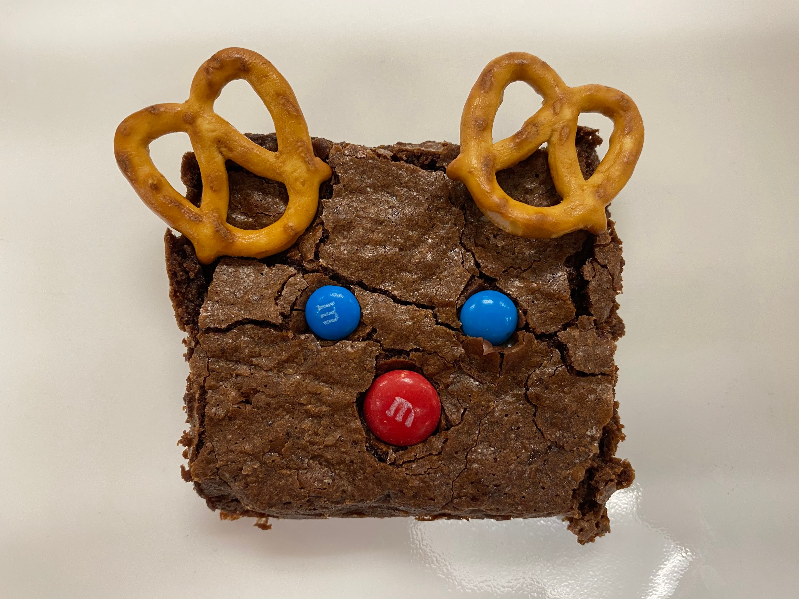
Montello School District | CTE NEWSLETTER - Fall 2020
Preparing students for career, college, and community.
Montello MS/HS adds Business Department
Patrick Griffith is the 1st year educator developing the business program recently implemented at Montello. He is a 2nd year educator and it is his 1st year at Montello. Bachelor Degree in Business Administration. He is currently teaching
FFA Highlights
What's Cooking?
Mr. Lloyd's Foods 1 students just wrapped up their Quick Bread Unit by making some tasty Chocolate Chip Muffins! Students also made pancakes and biscuits earlier in their Quick Bread Unit.
ProStart student, Lily Pierce made these festive Reindeer Brownies to celebrate the Holiday Season!
Mr. Lloyd's Foods 1 students just wrapped up their Quick Bread Unit by making some tasty Chocolate Chip Muffins! Students also made pancakes and biscuits earlier in their Quick Bread Unit.
ProStart student, Lily Pierce made these festive Reindeer Brownies to celebrate the Holiday Season!
What is CTE? CTE stands for Career and Technical Education. This includes our following departments: Business Ed, Family and Consumer Ed, Technology Ed, Art, and Agriculture Education.
Notes:
Intro to Horticulture (Dual Credit)
Animal Science Fundamentals (Dual Credit)
Weld/Metal Fab Intro and Safety (Dual Credit)
Related Welding (Dual Credit)

Slide 2
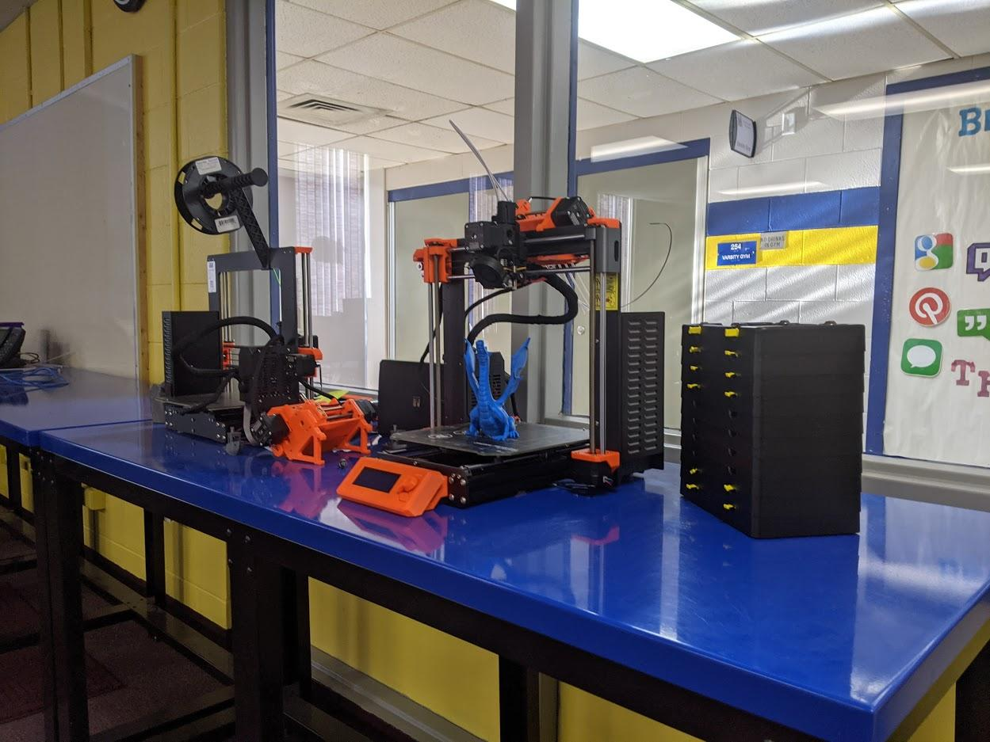
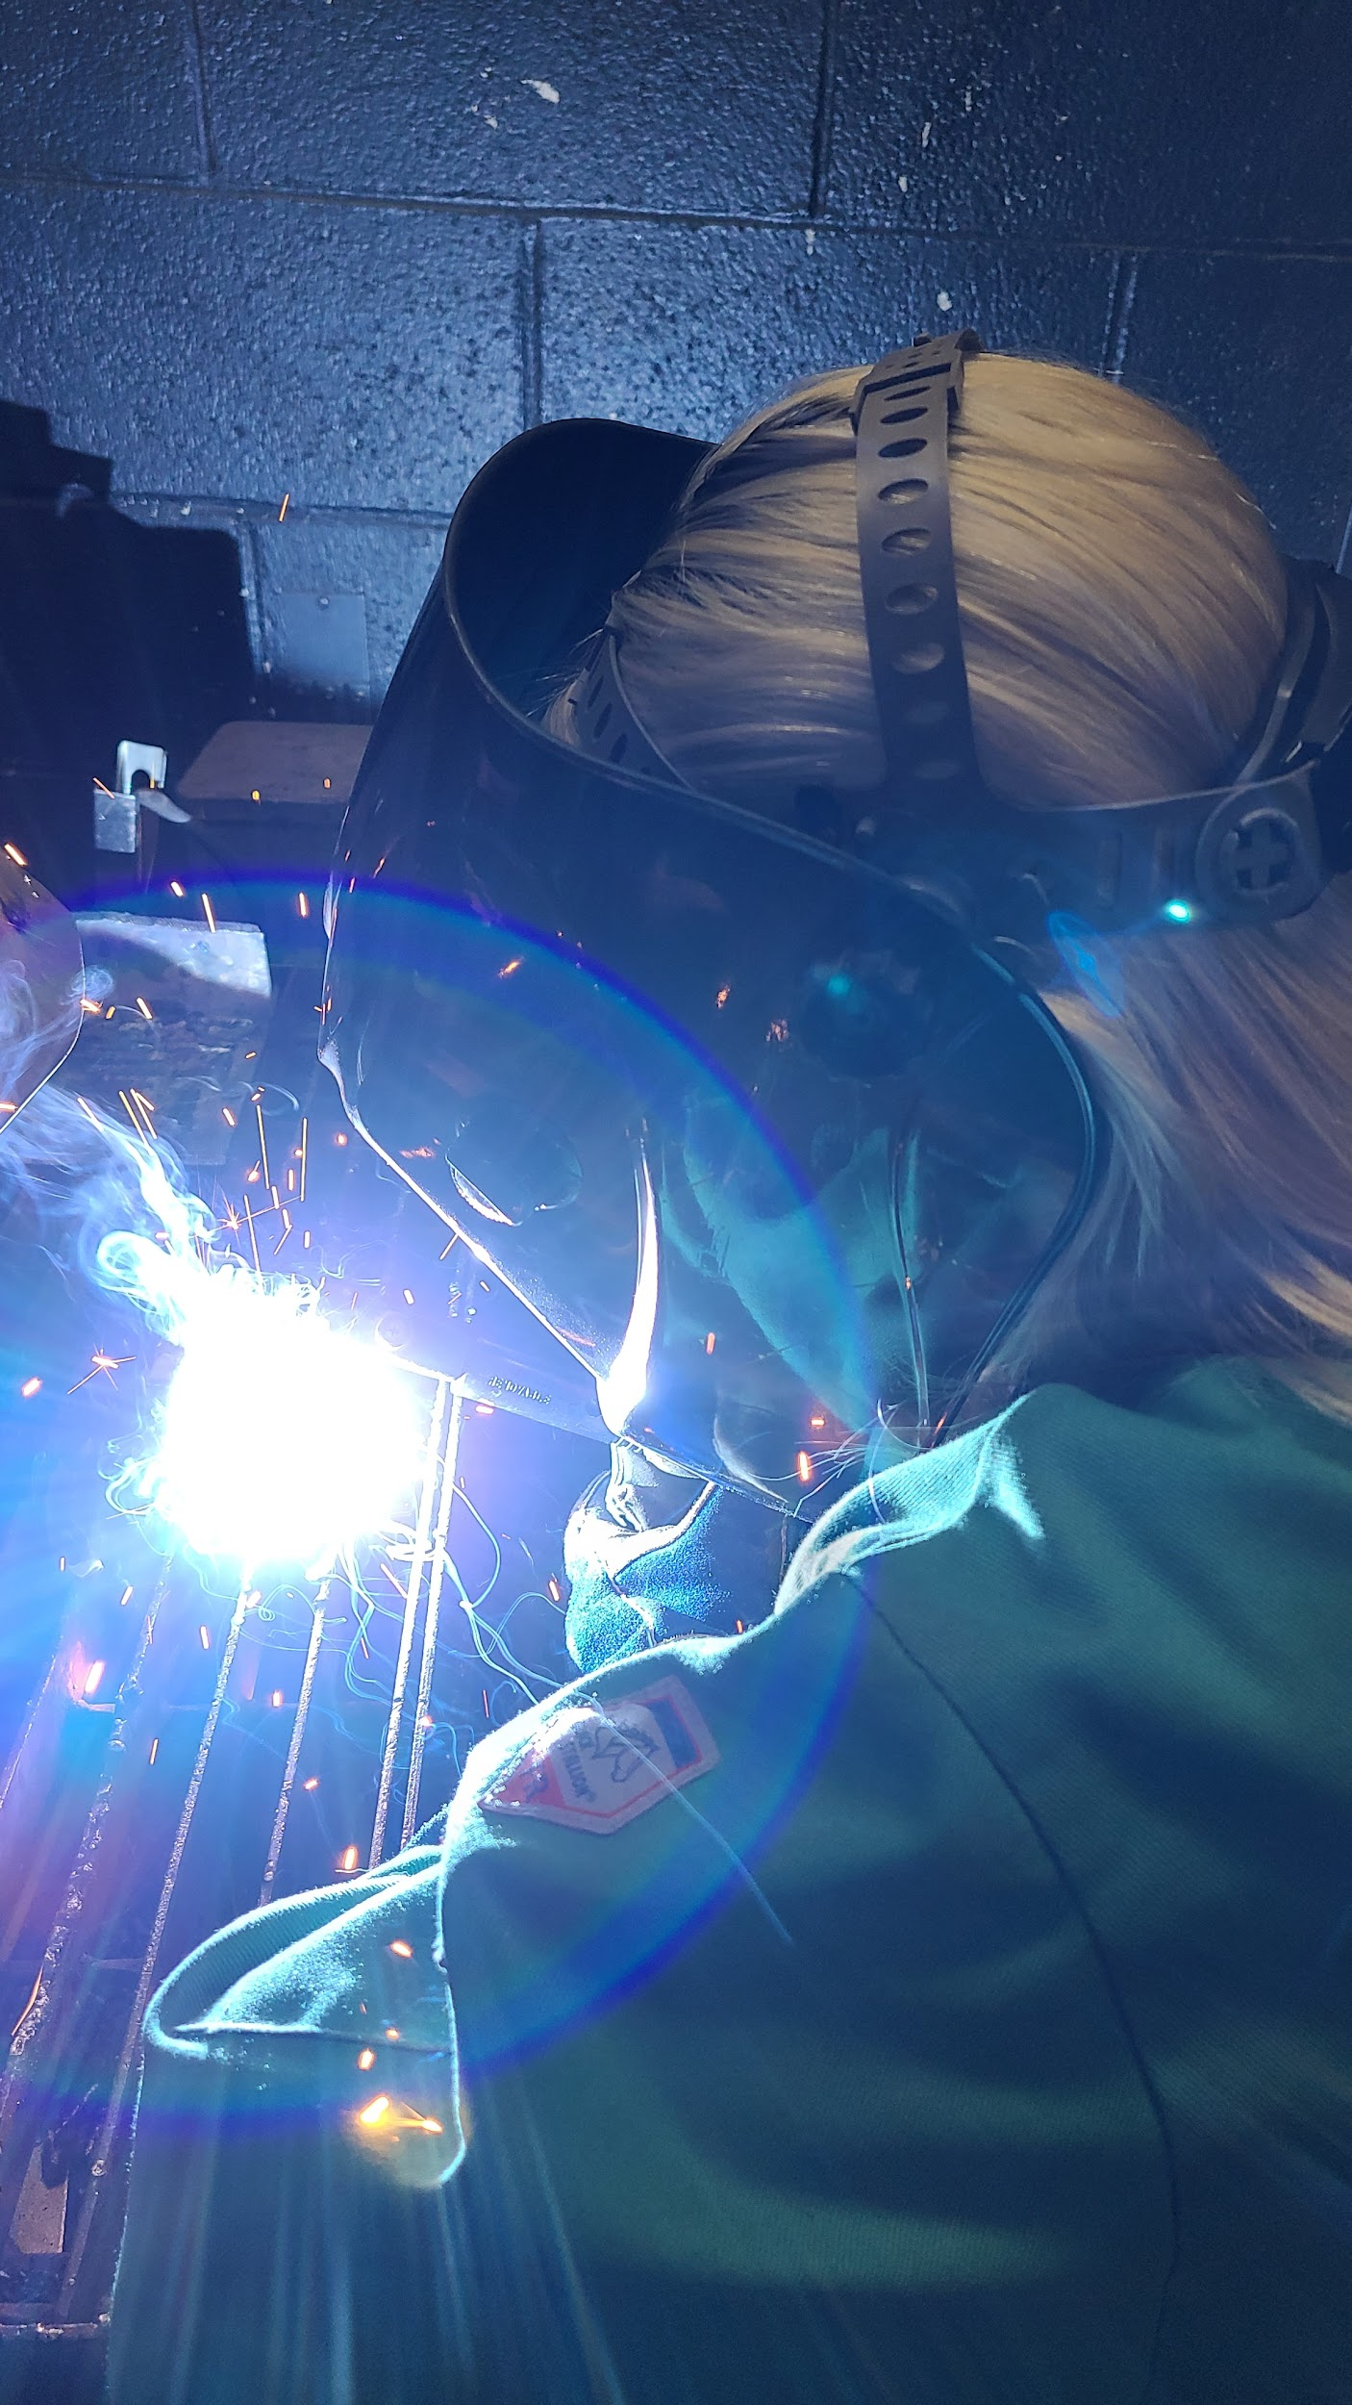
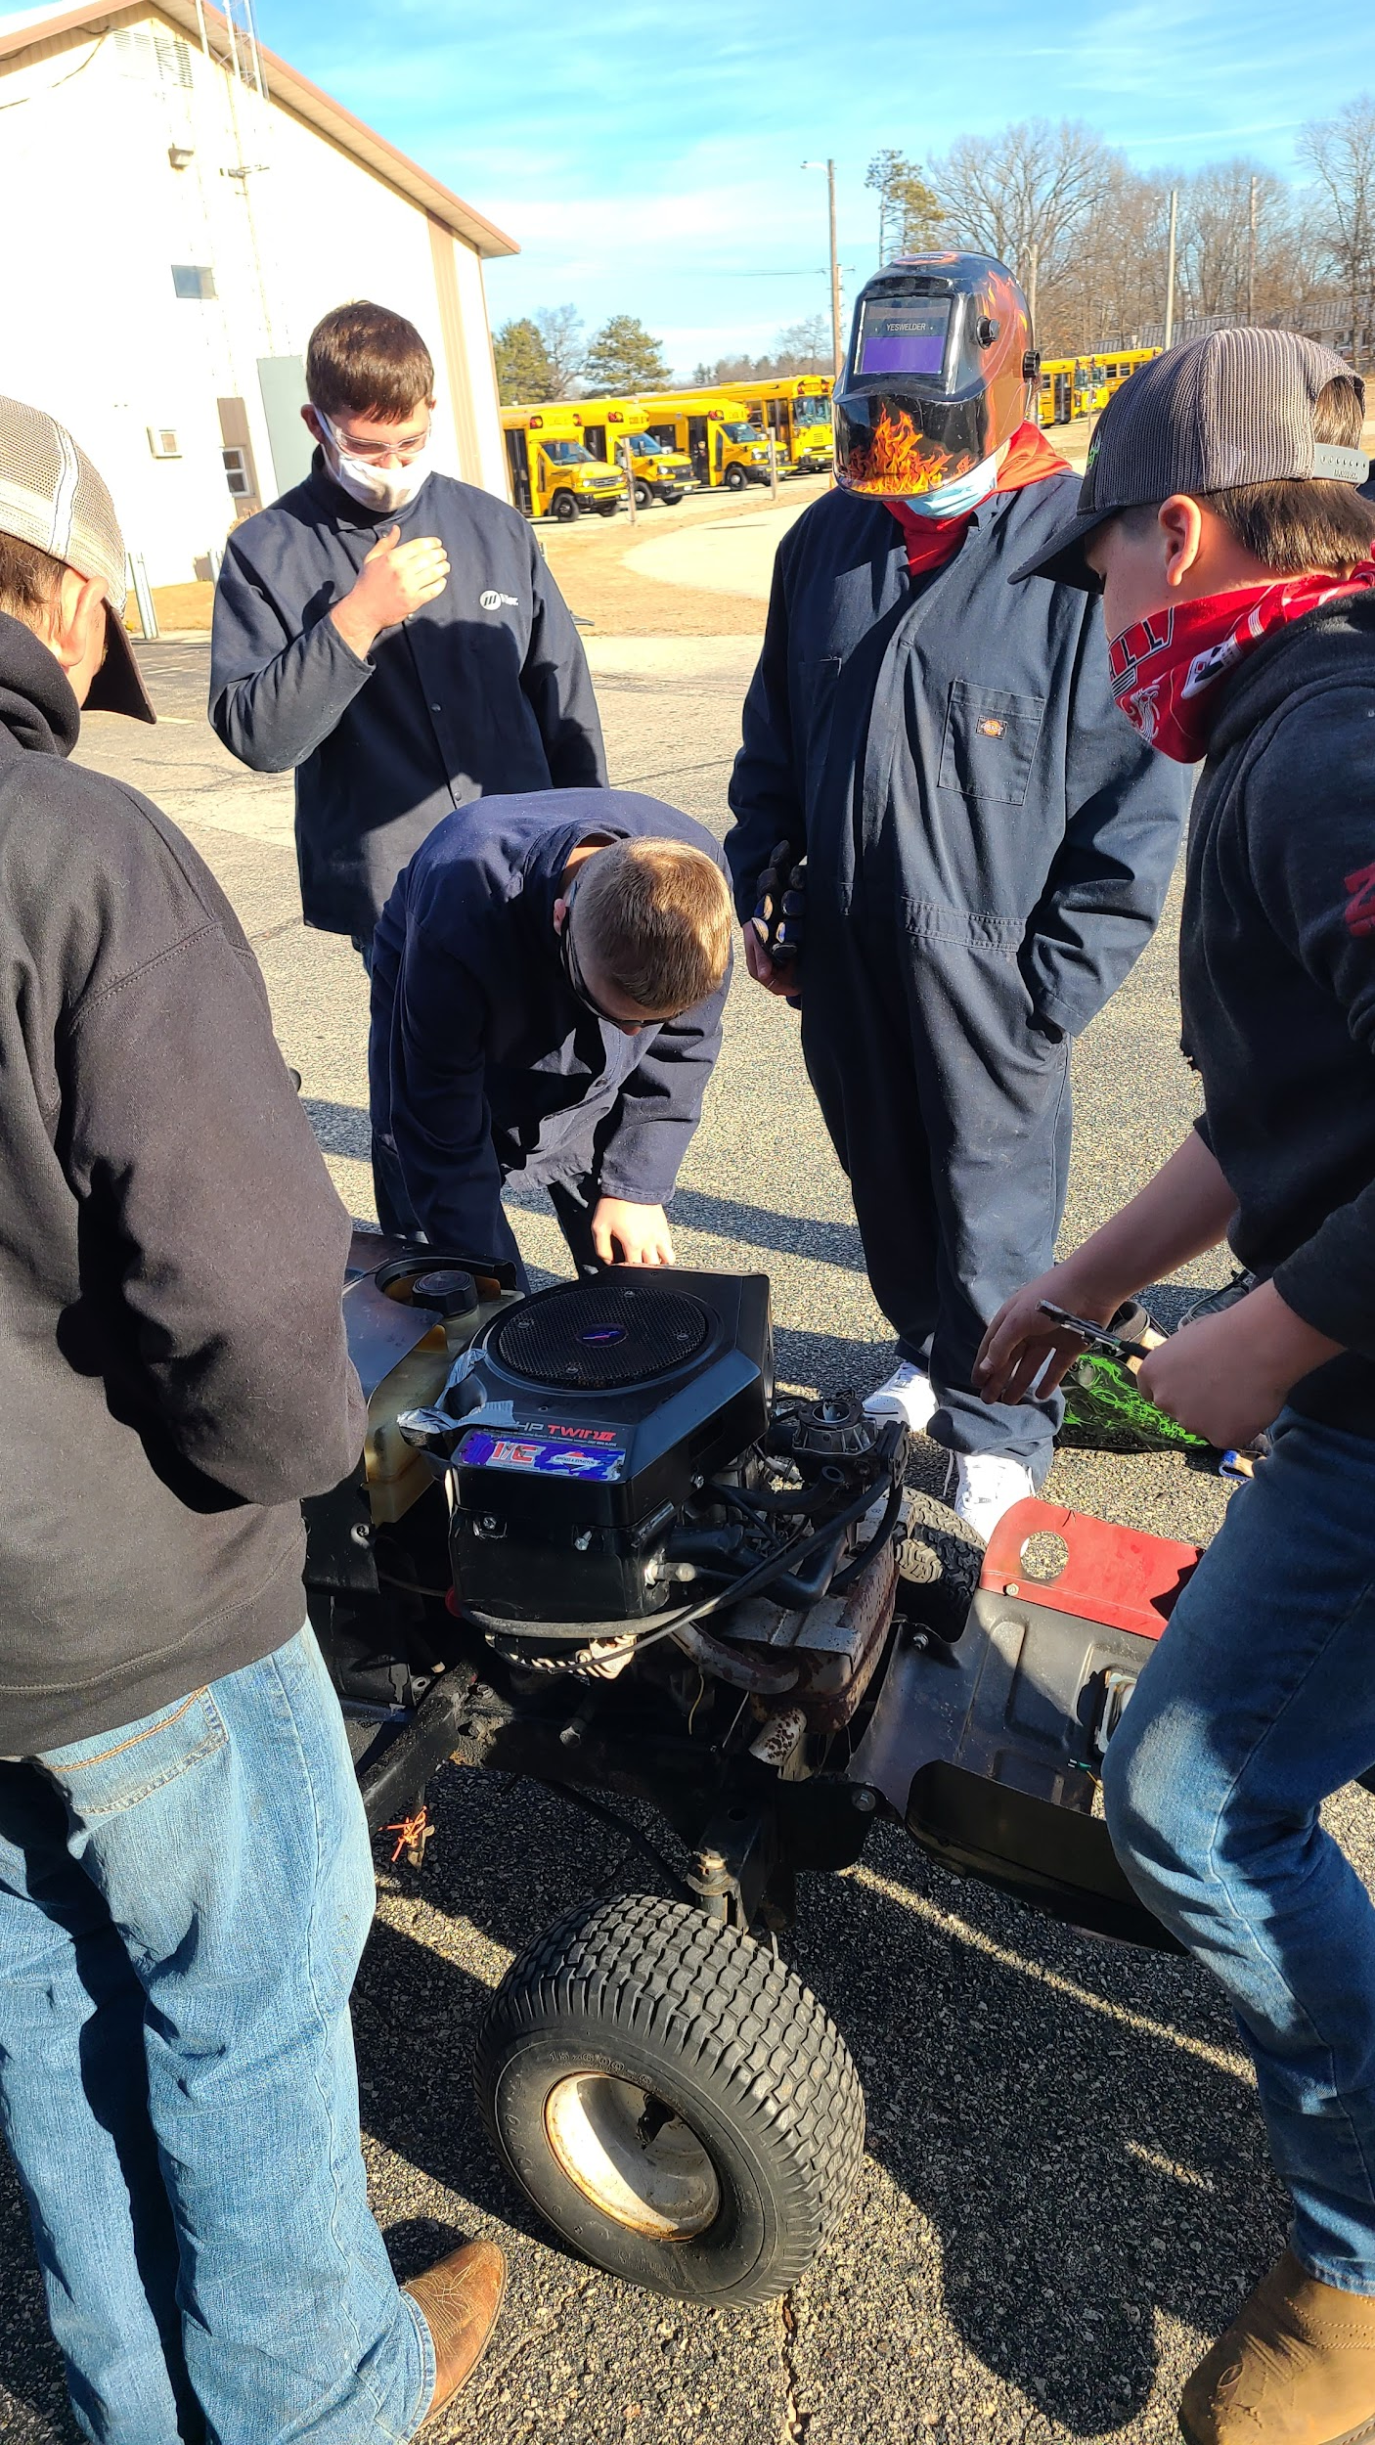
CTE Innovation Lab
We are currently working on developing a CTE Innovation Lab, a space where students, staff, and community members can create projects for class credit, fundraisers, or creative outlets using the cutting edge equipment we have at Montello School District. This space will host many of our additive and subtractive manufacturing equipment including the laser engraver, and 3D printers, as well as equipment to aid in technical creativity such as robotics and virtual reality. The Lab will also include our green
screen, poster printer, heat press, soldering tools, and wood engraving tools, and computer lab used for dual credit classes with technical colleges including software from Autodesk Inventor and Revit, Solidworks, Adobe Suites, and eventually Microsoft Suites.To fund this space we are applying to several different grants throughout the state including FY21, Compeer Financial, and Project Lead the way.
Dual Credit College Options
Sam Lloyd, the Family and Consumer Science Teacher, lead the charge in getting Dual Credit classes up and running for our high school students. We currently have a mix of classes in partnership with Madison Technical College and Fox Valley Technical College. Mrs. Wolsdorf is offering Intro to Horticulture, Animal Science Fundamentals, Metal Fab Intro and Safety, and Related Welding. Mrs Foght is offering Fundamentals of Construction, Intro to Woodworking, Sawing & Operations, CAD Drawing, Autodesk Inventor, and Solidworks. Sam Lloyd is teaching Pro Start 1 & 2,, People Skills in Health Profession 1&2nd, and Interior Design. In english we have Written Communication, science has natomy and Physiology and Medical Technology and math with Mr. Borud teaching Math Reasoning. By completing these classes our student are earning college credit for their transcripts!
Website:
https://www.montelloschools.org/
Contact:
608.492.1887
Email:
cte@montelloschools.org

